Slide 1

Class 12:
Threats to the Blockchain
Cryptocurrency Café
UVa cs4501 Spring 2015
David Evans
Image from http://www.theregister.co.uk/2015/02/22/lenovo_superfish_removal_tool/ (but I think they stole it from Monsters and Aliens)

Slide 2
Plan for Today
Difficulty Update
Project 2: Part 2
Superfish Calamity!
(Attacks on Blockchain)

Slide 3

Last Class: Profitability (?) of SP20
>> cumulative_income(1)
79.12571644571238
>>> cumulative_income(12)
571.0928818228372
>>> cumulative_income(24)
562.7786595271843
>>> cumulative_income(17)
619.9072133191279

Slide 4
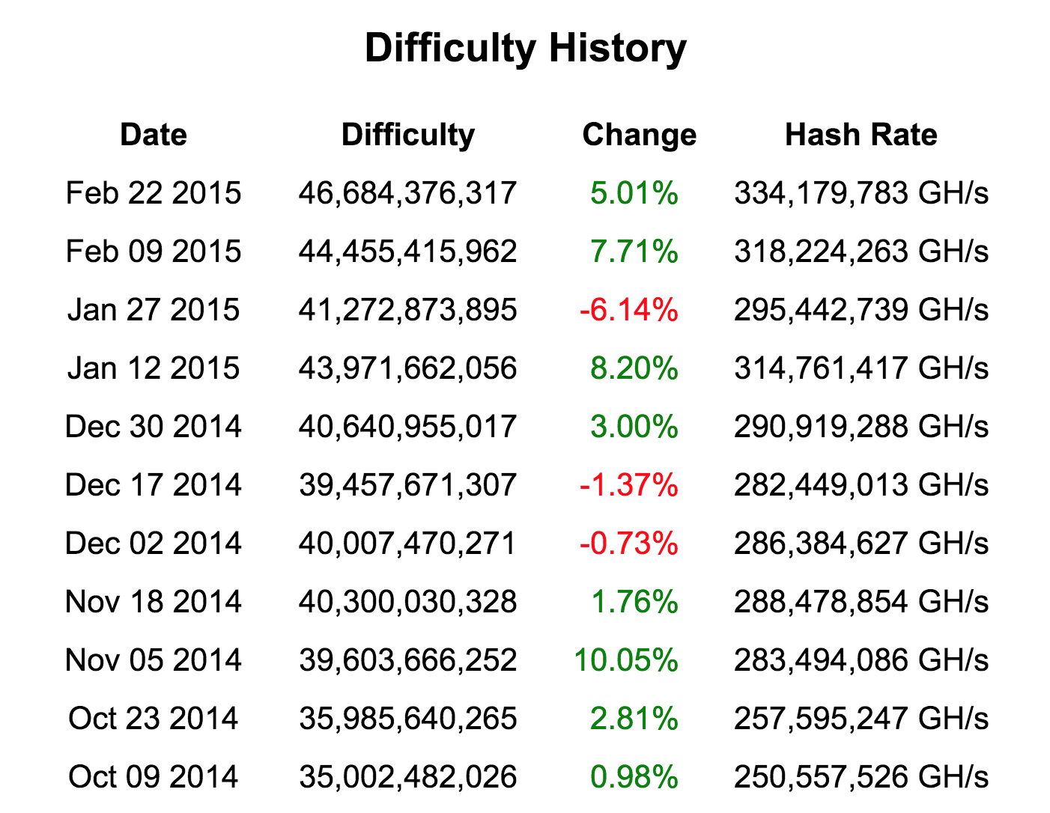
https://bitcoinwisdom.com/bitcoin/difficulty

Slide 5
difficulty = 46684376317 # updated 22 Feb 2015
# 44455415962 # from https://blockchain.info/stats, 15 Feb 2015
# this is a very low assumption - over past year, average rate was 0.35
rate_of_difficulty = 0.05
…
def cumulative_income(months):
income = 0.0
month = 0
while month < months:
income += expected_income(month)
month += 1
return income
Old difficulty:
>> cumulative_income(1)
79.12571644571238
>>> cumulative_income(12)
571.0928818228372
>>> cumulative_income(17)
619.9072133191279
Note: actual increase since Jan 29: 0.13
New difficulty:
>>> cumulative_income(1)
72.41808586293124
>>> cumulative_income(12)
508.6688931963315
>>> cumulative_income(16)
540.5796294385948
>>> cumulative_income(17)
540.5038281854024

Slide 6
difficulty = 46684376317 # updated 22 Feb 2015
# 44455415962 # from https://blockchain.info/stats, 15 Feb 2015
# this is a very low assumption - over past year, average rate was 0.35
rate_of_difficulty = 0.13
…
def cumulative_income(months):
income = 0.0
month = 0
while month < months:
income += expected_income(month)
month += 1
return income
Old difficulty:
>> cumulative_income(1)
79.12571644571238
>>> cumulative_income(12)
571.0928818228372
>>> cumulative_income(17)
619.9072133191279
Note: actual increase since Jan 29: 0.13
New difficulty:
>>> cumulative_income(1)
72.41808586293124
>>> cumulative_income(12)
508.6688931963315
>>> cumulative_income(16)
540.5796294385948
>>> cumulative_income(17)
540.5038281854024
At 13%:
>>> cumulative_income(1)
72.41808586293124
>>> cumulative_income(7)
239.03863987346259
>>> cumulative_income(8)
234.54128929077427

Slide 7
from Feb 18 (Class 11):

Slide 8


from Feb 18 (Class 11):
this morning (Feb 23):

Slide 9
PointCoin Difficulty

Slide 10
Block | Difficulty | Eastern Time
1152 | 261,980,454 | 2/23/15 12:21
1128 | 95,822,823 | 2/23/15 10:46
1104 | 229,149,558 | 2/23/15 1:08
1080 | 321,954,988 | 2/22/15 19:30
1056 | 80,846,341 | 2/22/15 18:27
1032 | 310,174,797 | 2/22/15 3:04
1008 | 109,379,471 | 2/22/15 1:16
984 | 68,483,655 | 2/21/15 22:41
971 | 148,690,322 | 2/21/15 18:53
960 | 148,690,322 | 2/21/15 13:53
936 | 44,452,195 | 2/21/15 12:40
912 | 59,569,021 | 2/21/15 7:18
888 | 43,485,379 | 2/21/15 4:22

Slide 11

Project 2
Part 2 starts after class today
Understand threats to the blockchain
Attack the PointCoin network

Slide 12
Rules
The blockchain reported by http://blockexplorer.bitcoin-class.org/ is the blockchain that matters (if that node is taken down, the definitive blockchain will be one taken from the course staff nodes)
You may not use any active computing power for mining other than your EC2 nodes
You may not misuse any University resources
You may not do anything that violates Amazon’s acceptable use policy (http://aws.amazon.com/aup/)

Slide 13
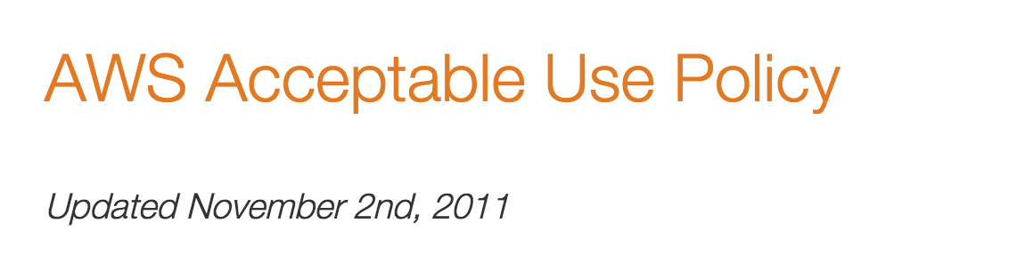
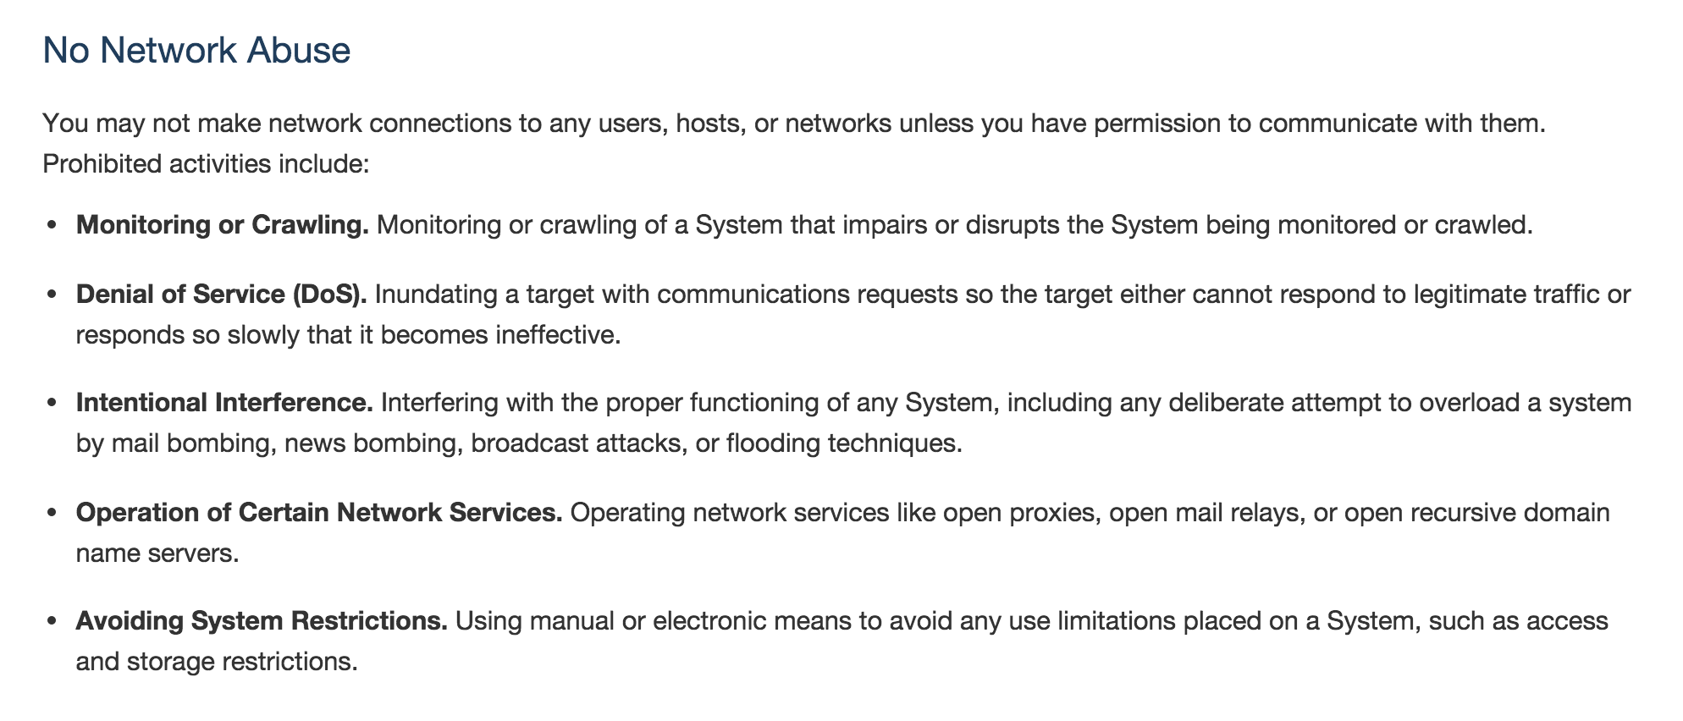

Slide 14
Opportunities
Collusion is permitted (indeed, encouraged!)
You should have mutual distrust for your classmates (just for this assignment!)
If you join a mining pool, it is encouraged that you (attempt to) deceive the pool operator (or other pools) to gain an advantage
If you operate a mining pool, fine to attempt to cheat pool members

Slide 15
Do Something Else!
Posted Project 2 / Part 2 is the default.
I hope some students will do other things!
Alternatives:
Build a PointCoin exchange
Use scripts in interesting ways
Build naming service using PointCoin
…
If you have an idea for something different to do, let me know.

Slide 16

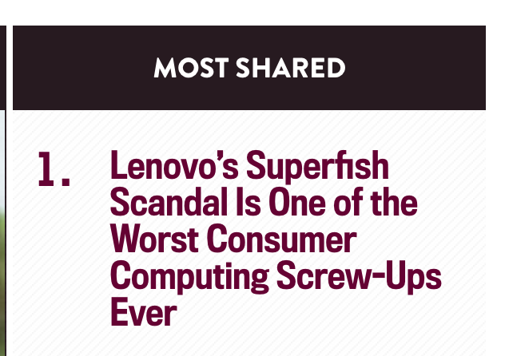
What Happened with Lenovo?

Slide 17
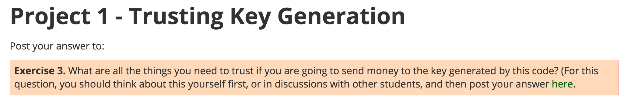

Slide 18
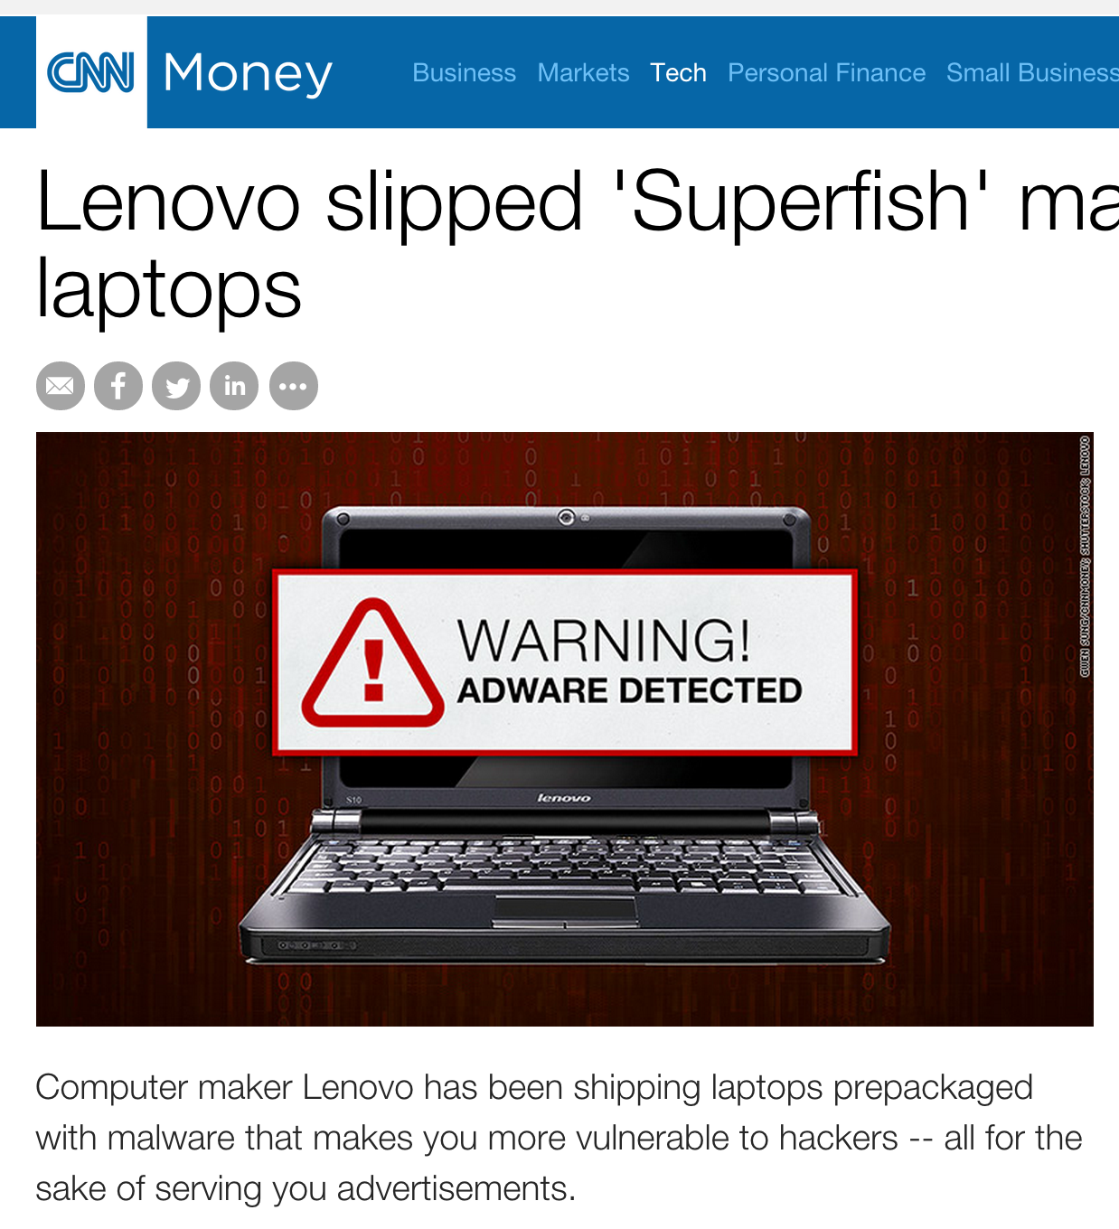
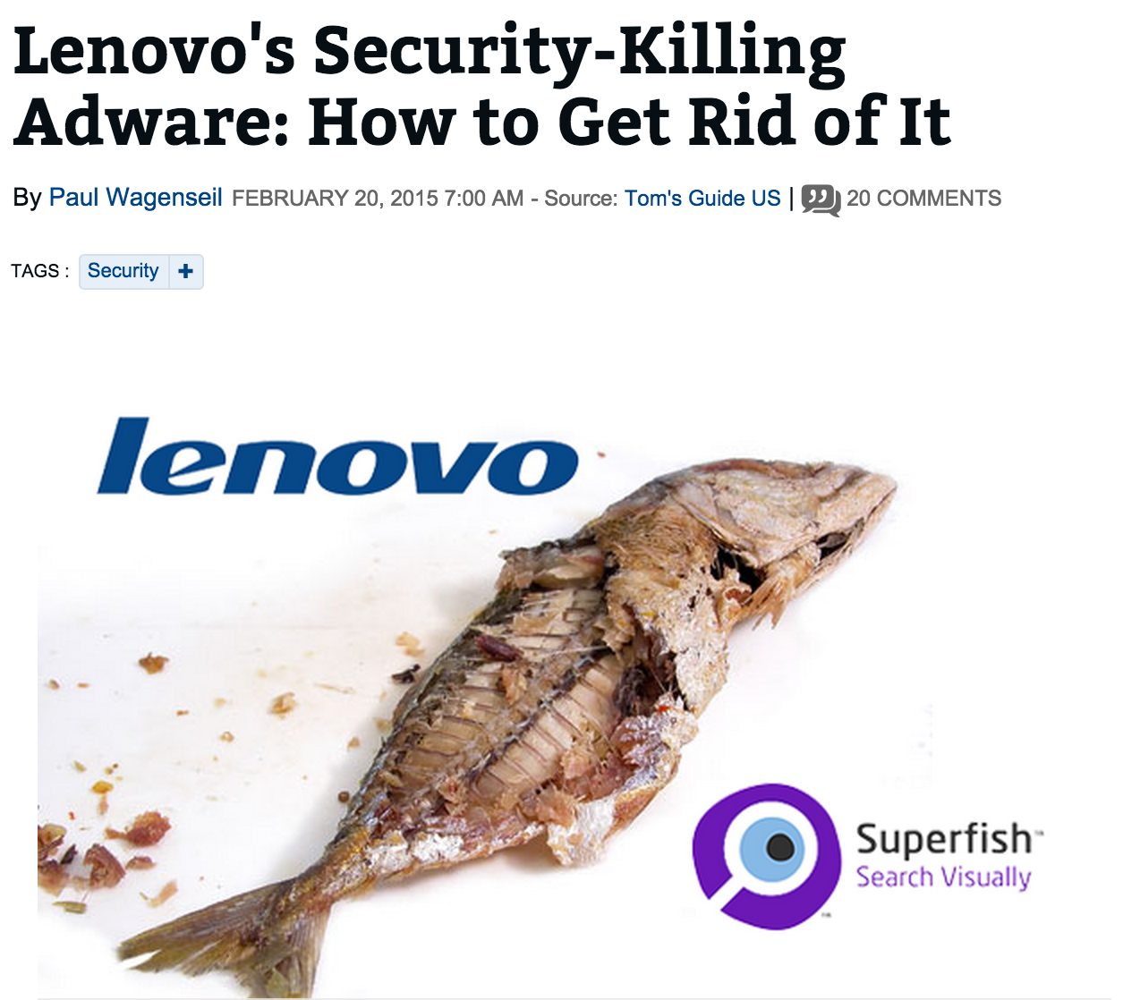
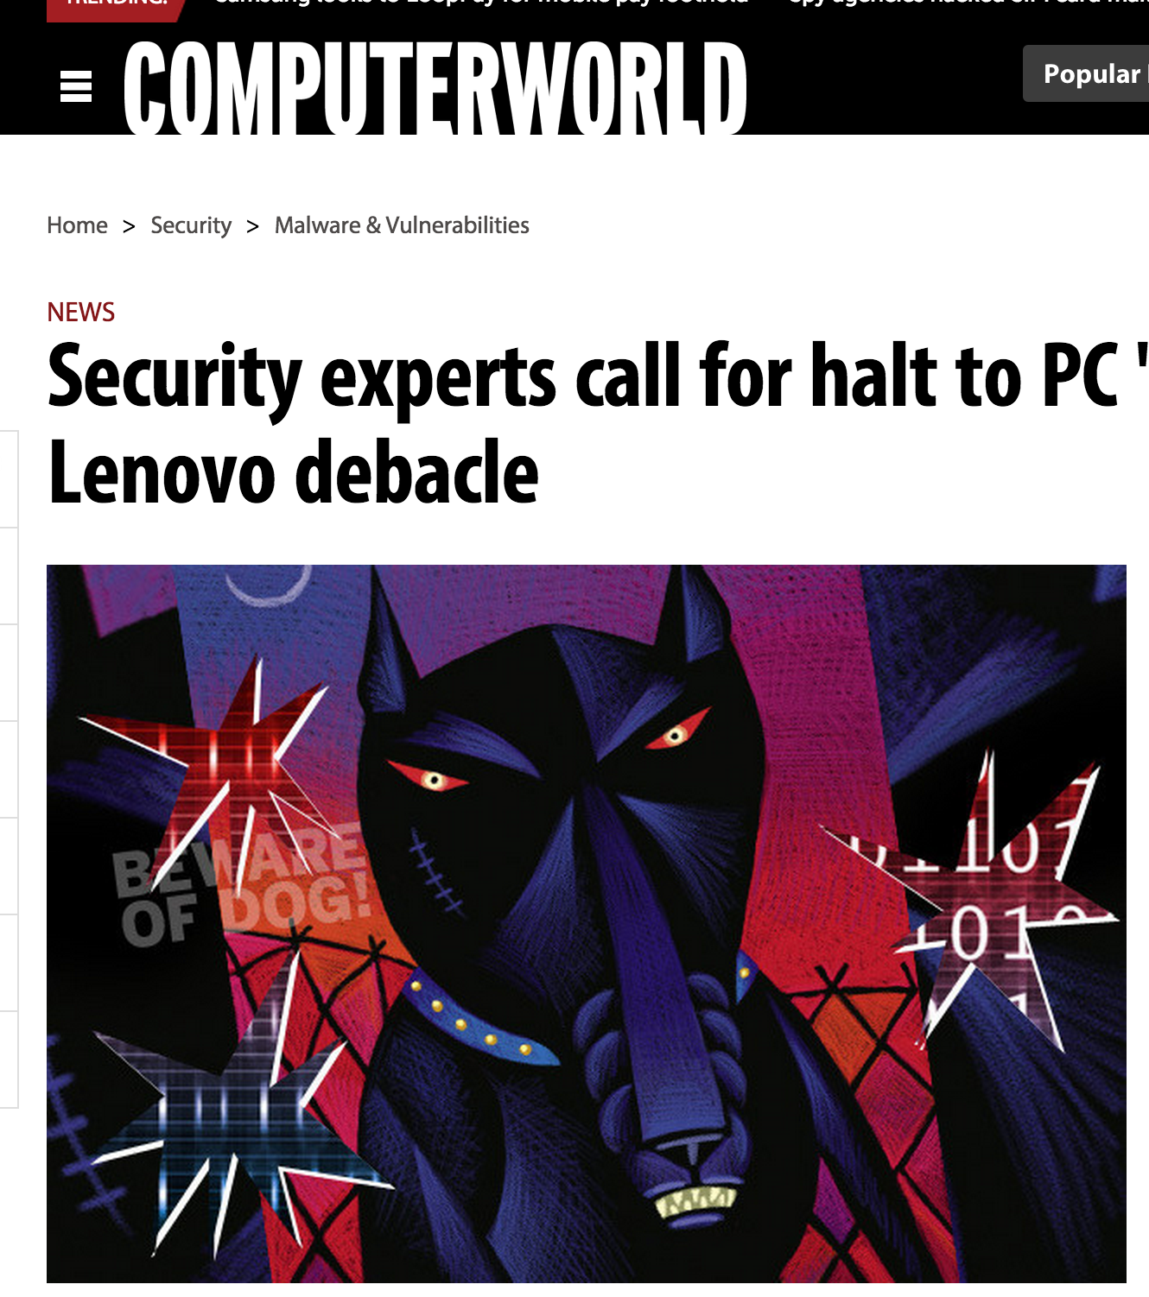

Slide 19
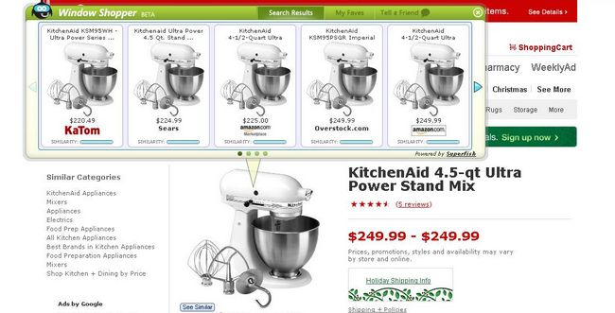
https://www.google.com/#q=chair

Slide 21
SSL (Secure Sockets Layer)
Client
Server
Hello
Verify Certificate using KU_{CA}
Check identity matches URL
Generate random K
KR_{CA}[Server Identity, KU_{S}]
E_{KUS} (K)
Decryptusing KR_{S}
Secure channel using K
Simplified TLS Handshake Protocol

Slide 22
SSL (Secure Sockets Layer)
Client
Server
Hello
Verify Certificate using KU_{CA}
Check identity matches URL
Generate random K
KR_{CA}[Server Identity, KU_{S}]
How did client get KU_{CA}?
E_{KUS} (K)
Decryptusing KR_{S}
Secure channel using K
Simplified TLS Handshake Protocol

Slide 25
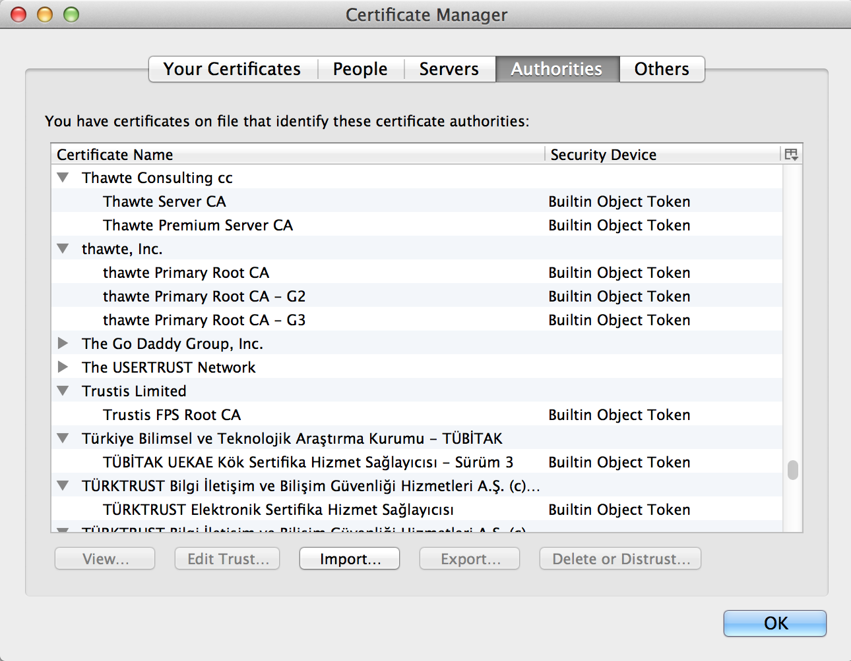

Slide 26
Certificates
How does VarySign decide if it should give certificate to requester?
VarySign.com
petitions.gov, KU_{Petitions}
C_{P} = KR_{VarySign}[“petitions.gov”, KU_{Petitions}]
TJ
C_{P}
Verifies using KU_{VarySign}
Petitions

Slide 27
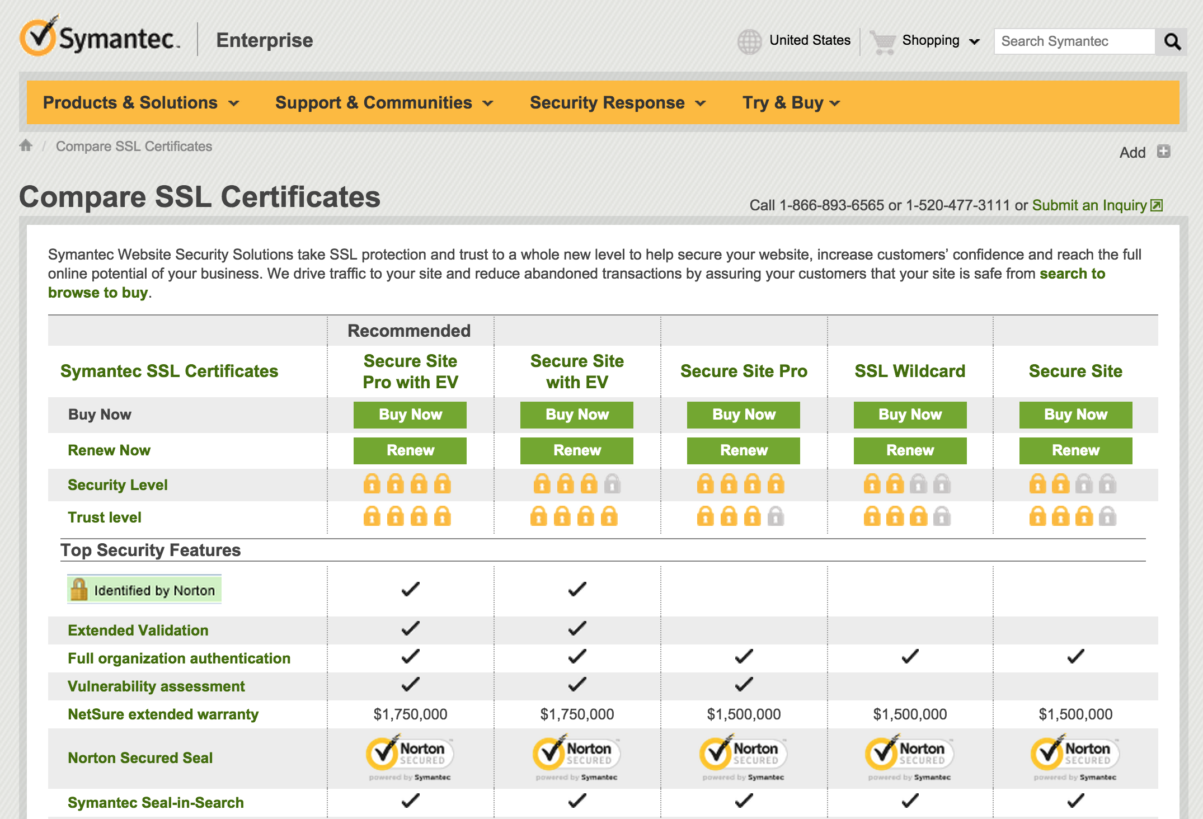
$399
$1499 for 1 year

Slide 28
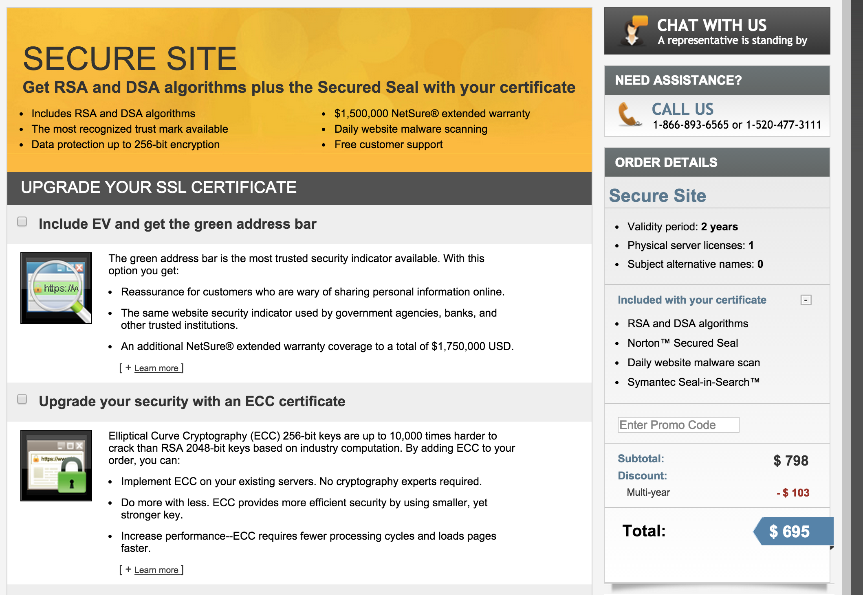

Slide 29
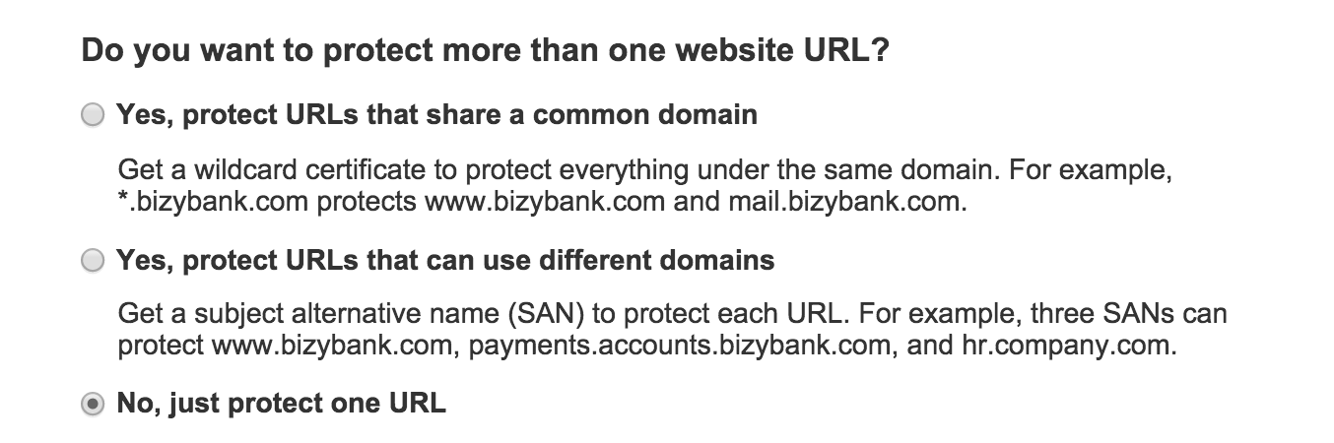

Slide 30
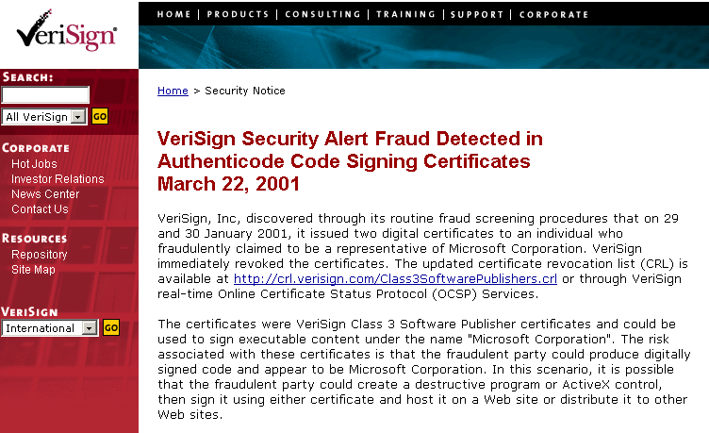
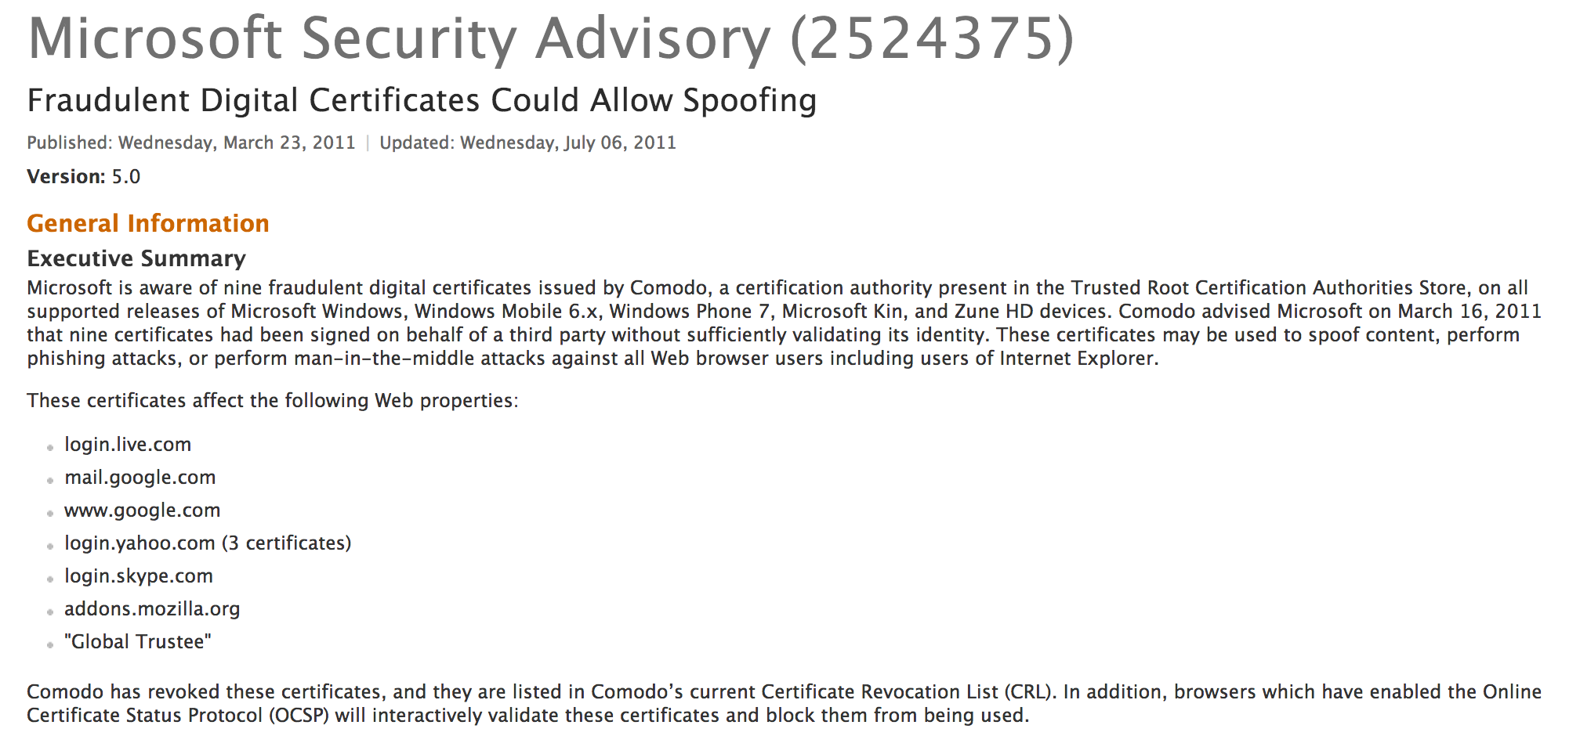
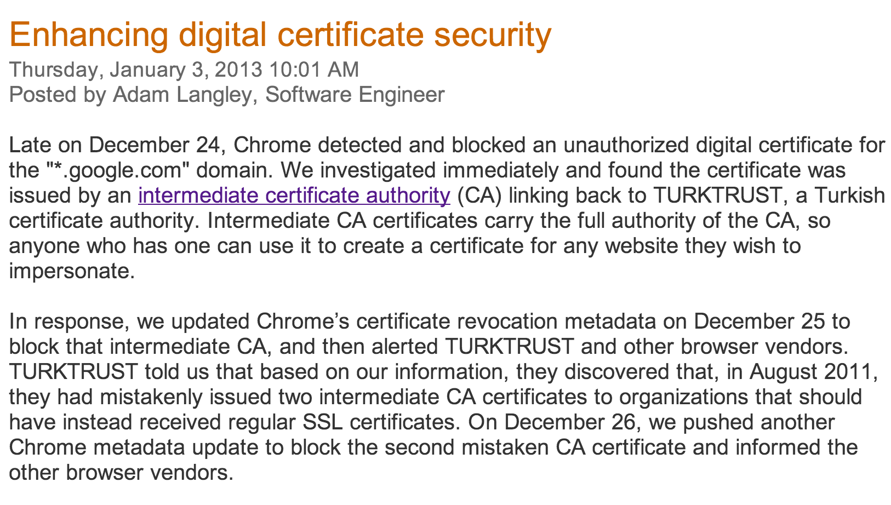

Slide 31
How could SuperFish insert ads in SSL traffic?

Slide 32
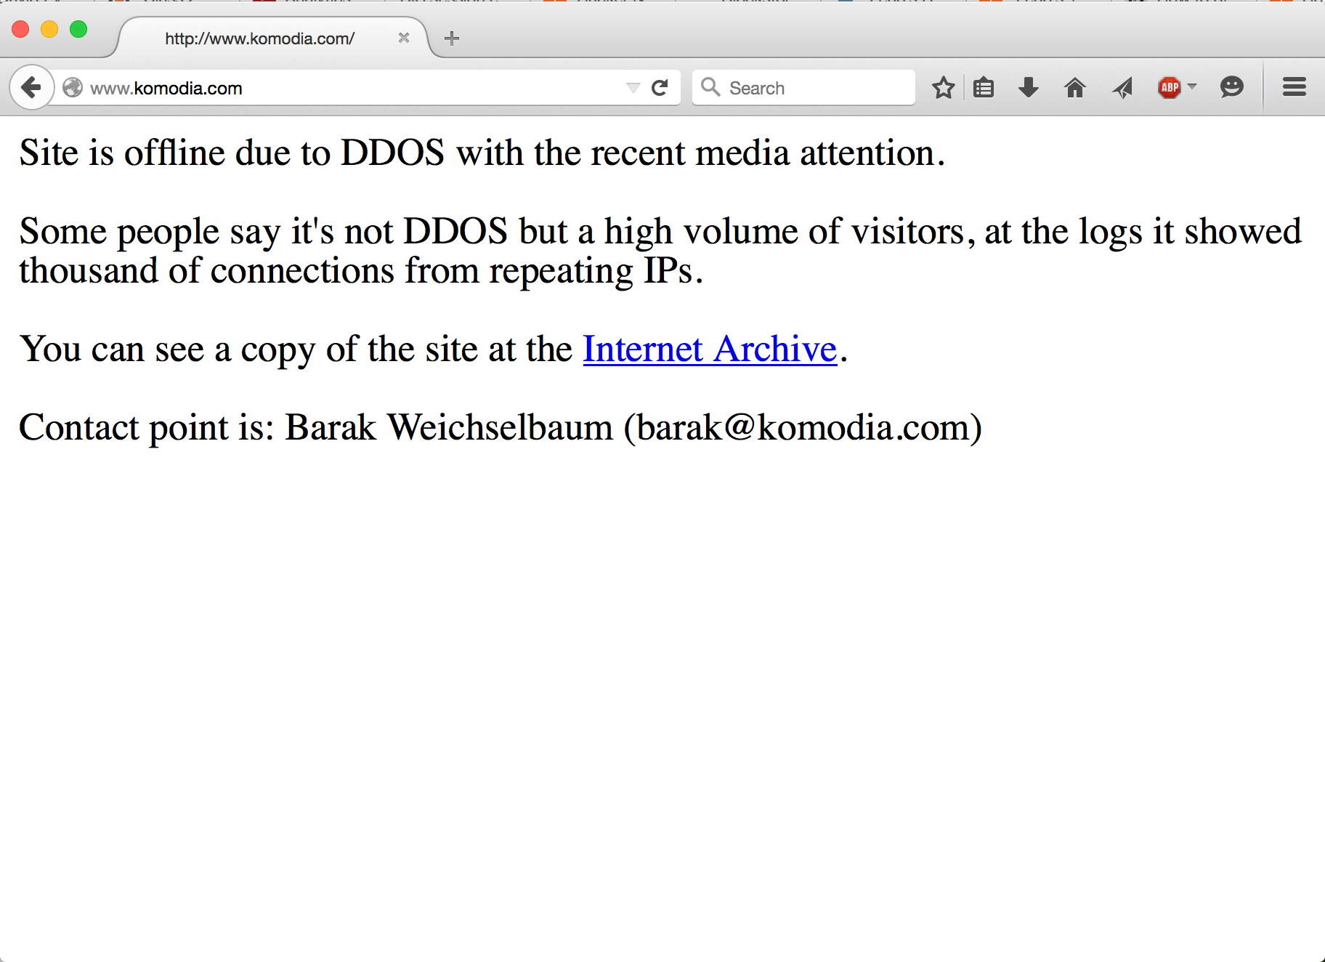
Reminder: do not launch DDOS attacks on PointCoin!

Slide 33
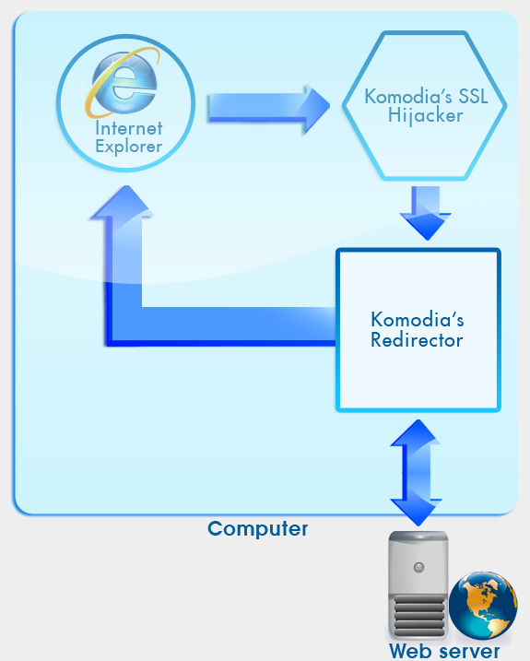
Internet explorer connects to a web server on port 443 using SSL. The data is encrypted.
Komodia’s SSL hijacker intercepts the communication and redirects it to Komodia’s Redirector. The channel between the SSL hijacker and the Redirector is encrypted.
At this stage, Komodia’s Redirector can shape the traffic, block it, or redirect it to another website.
Communication between the Redirector and the website is encrypted using SSL.
All data received from the website can be again modified and/or blocked. When data manipulation is done, it is forwarded again to Internet explorer.
The browser displays the SSL lock, and the session will not display any “Certificate warnings”.
http://www.komodia.com/products/komodias-ssl-decoderdigestor (in archive.org)

Slide 34
SSL (Secure Sockets Layer)
Client
Server
Hello
Verify Certificate using KU_{CA}
Check identity matches URL
Generate random K
KR_{CA}[Server Identity, KU_{S}]
E_{KUS} (K)
Decryptusing KR_{S}
Secure channel using K
Simplified TLS Handshake Protocol

Slide 35
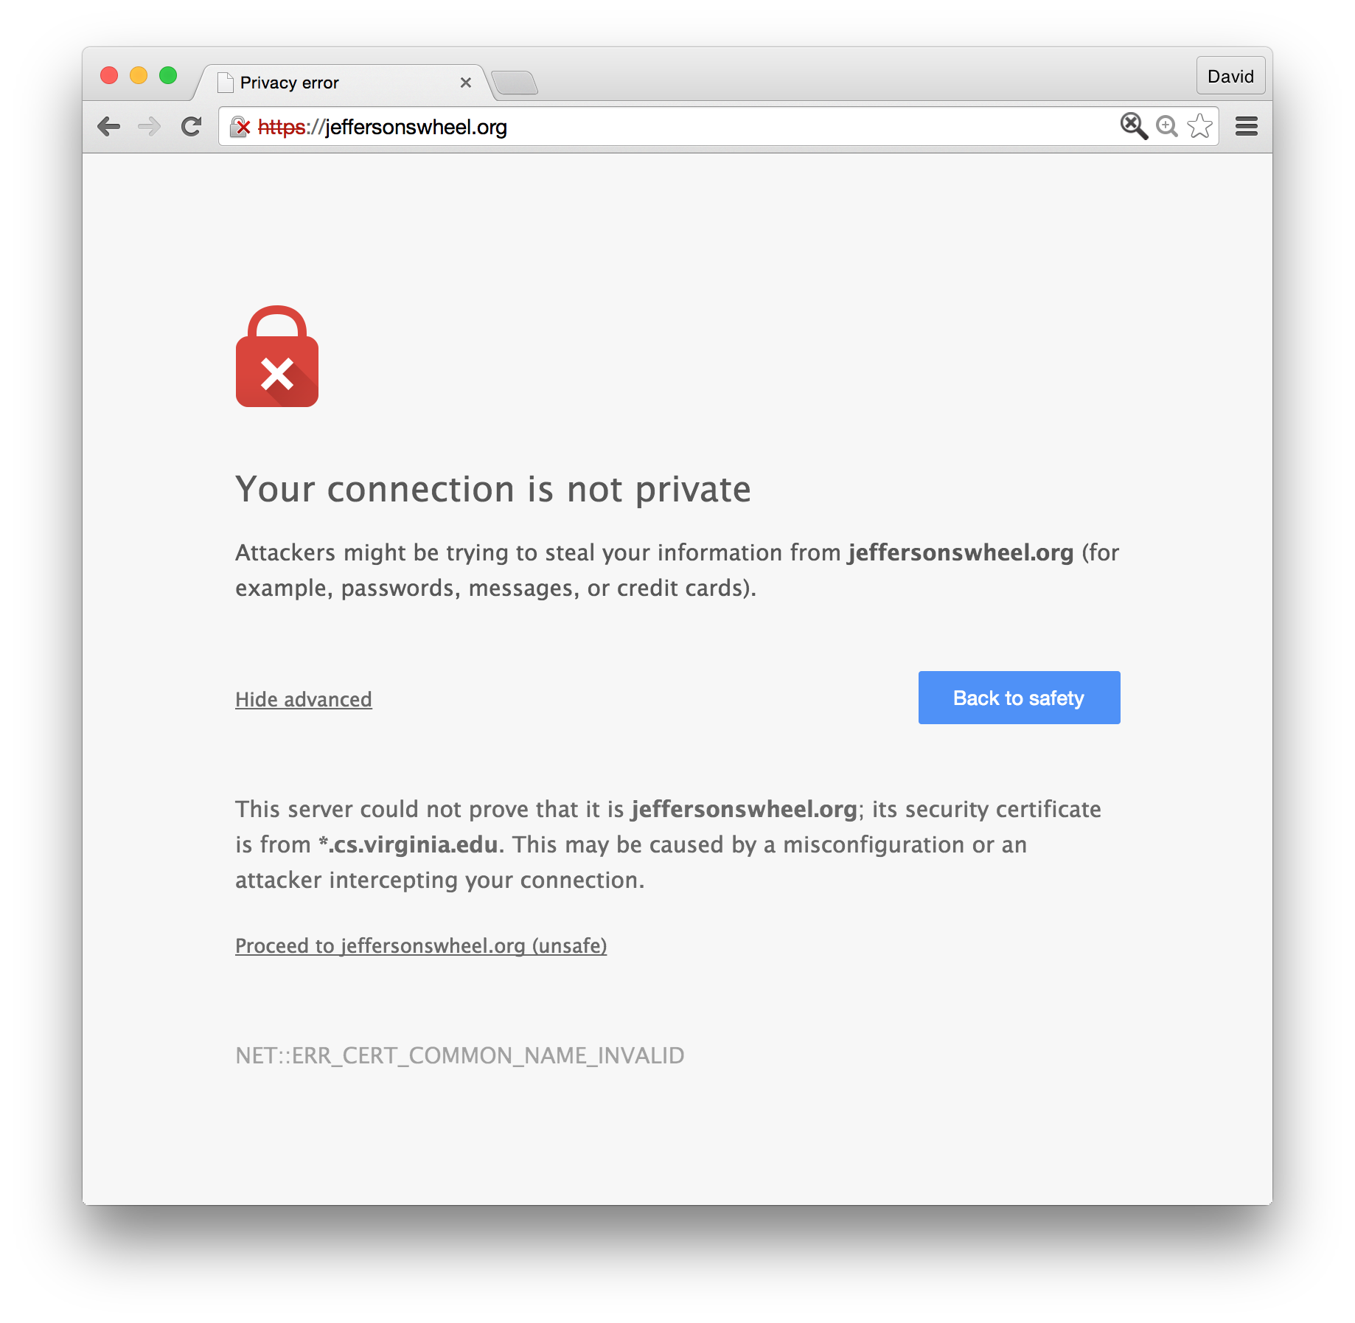

Slide 38
Attacks on the Blockchain

Slide 39
Pooling Miners
https://www.antpool.com/poolStats.htm

Slide 40
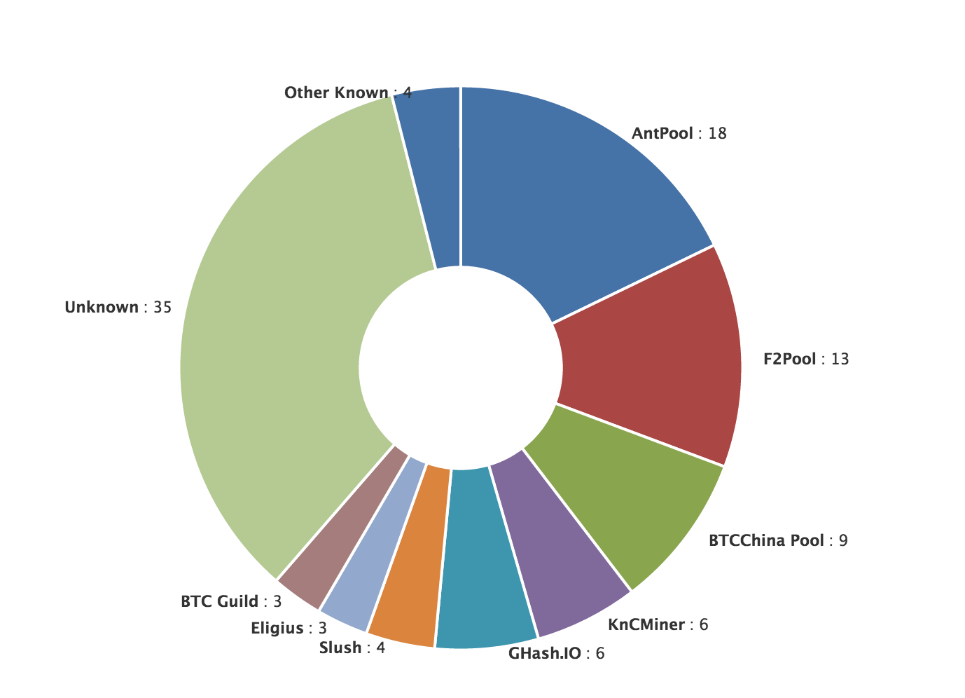
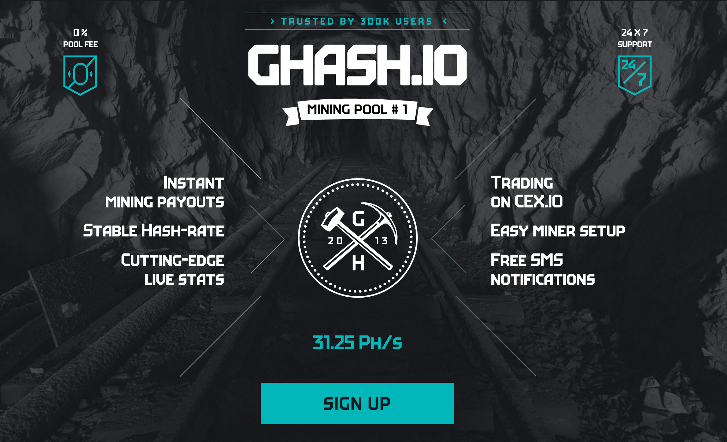
Mining Pool Dangers

Slide 41
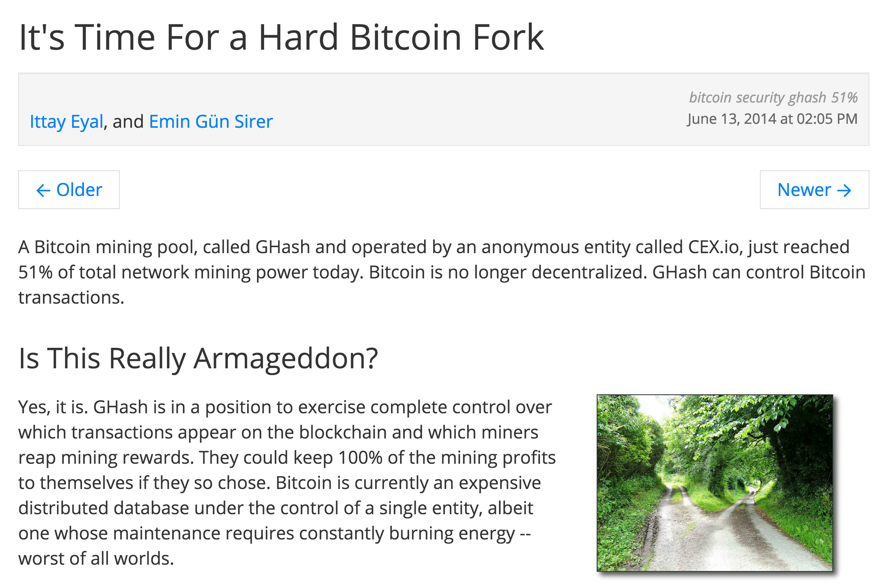

Slide 42
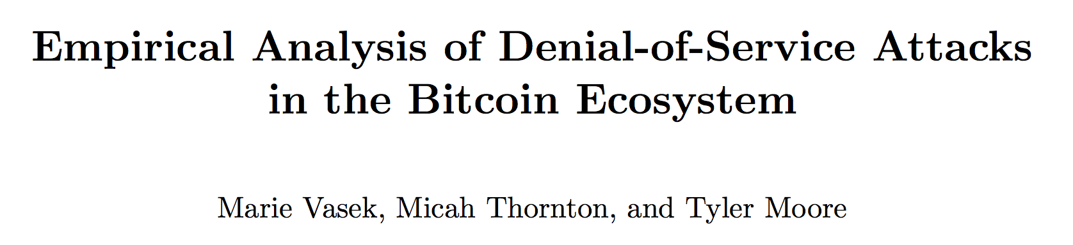
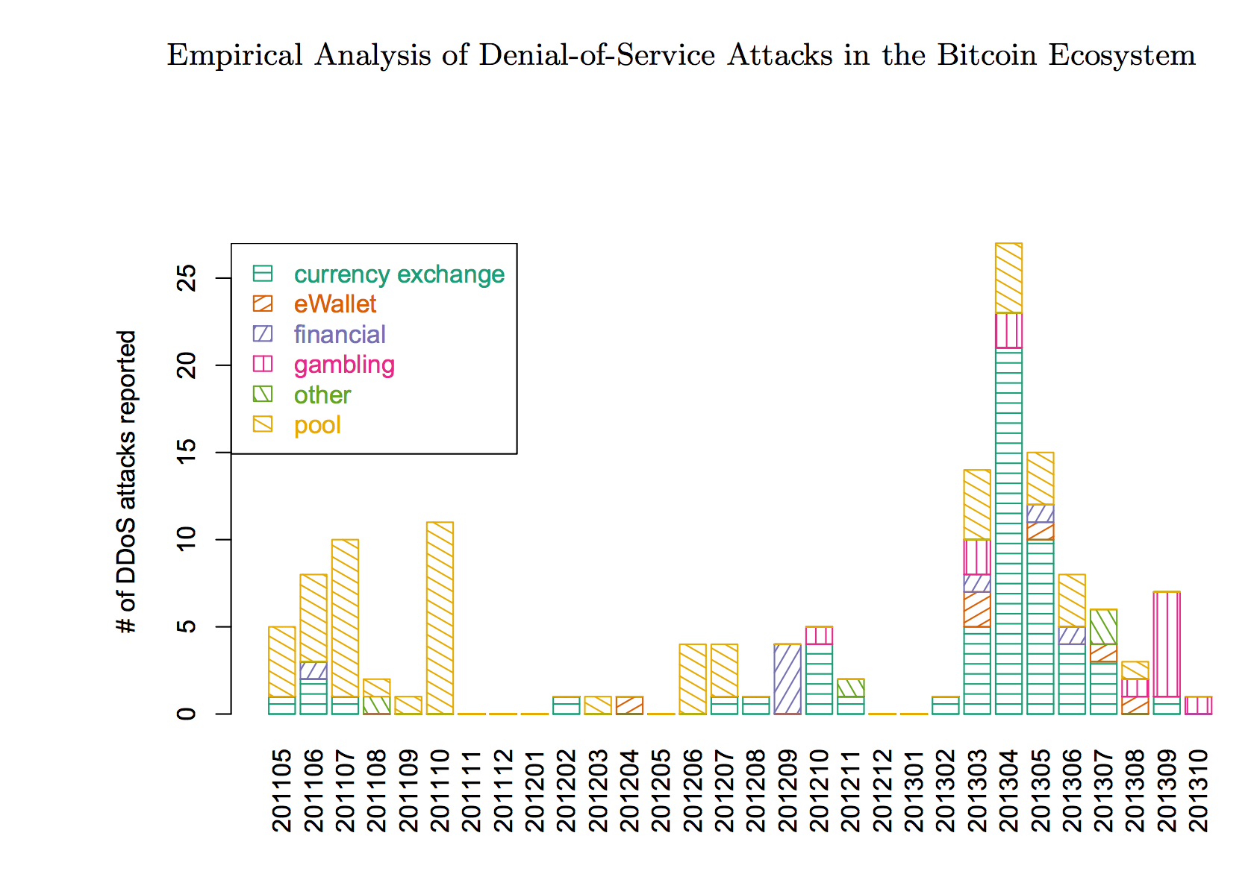
Mining Pool Attacks
DDOS-ing
Block Withholding
Lots of interesting questions about this and ongoing research…we’ll talk more in future classes. Many possible project ideas about mining pool dangers and attacks on mining pools.

Slide 43
Charge
Project 2 Part 2:
Starts Now
Due Thursday 5 March
Quiz Wednesday

